Slide 1


BOOK HAVEN
Presented by
PRATIKSHA PATIL(233188)
SNEHAL PATIL(233180)
Mrs. Rupali Thorat Project Guide

Slide 2
Point to be Disscuss through out the Presentation
Introduction
Motivation
Objective
UML Diagrams
Screenshot
Technology
Software Requirement
Hardware Requirement
Advantages
Disadvantages
Conclusion
Future Enhancement
References

Slide 3
Introduction
The Bookhaven system based on the principle of provides service and facility to users to buy the book online.
The main aim of this system is to create a website where a customer can visit and buy books online and delivered to his/her doorsteps.
The online book store has some functions, by which customer can register and buy some books.
System administrator responsible for managing books and category.
Using the system, customer can buy book from anywhere ultimately saves time and efforts.

Slide 4

As a local vendor or shop they can sell the books in their locality only if they want to expand physically a lot of cost is required
As a customer point of view you have to visit the book store to buy the book and you don’t know whether that store have the book that you want and it cost time

Slide 5
Objective
In Existing system , customer need to visit book store . Select the types of books and finding the books as per requirement is time consuming and tedious task .
Online book store broke the management mode of traditional bookstore provide facility to customer to buy the book from anywhere which ultimately saving time and efforts.

Slide 6
Unified Modelling language (UML Diagram)

Slide 7
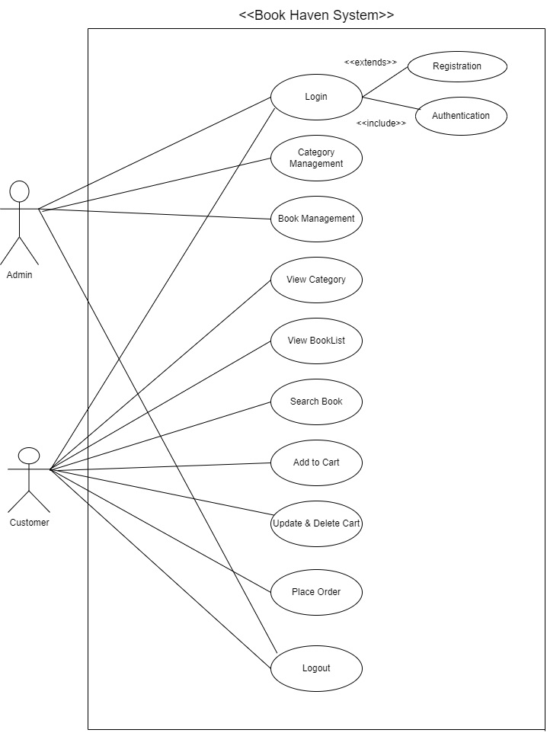
USE CASE DIAGRAM

Slide 8
Entity Relationship Diagram

Slide 9
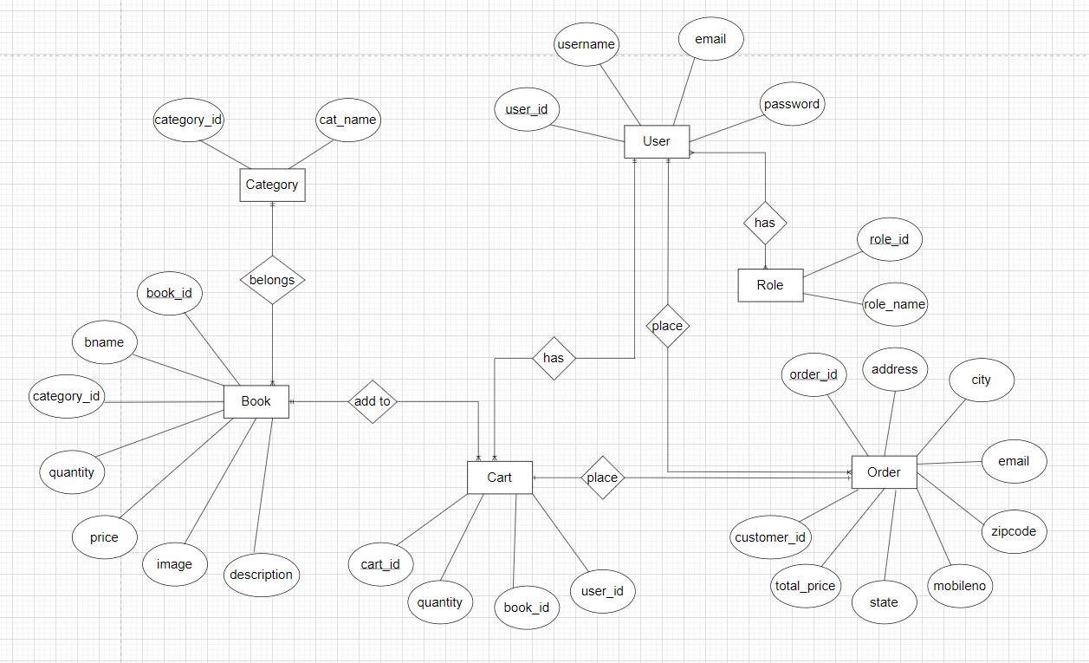

Slide 10
Screenshots

Slide 11
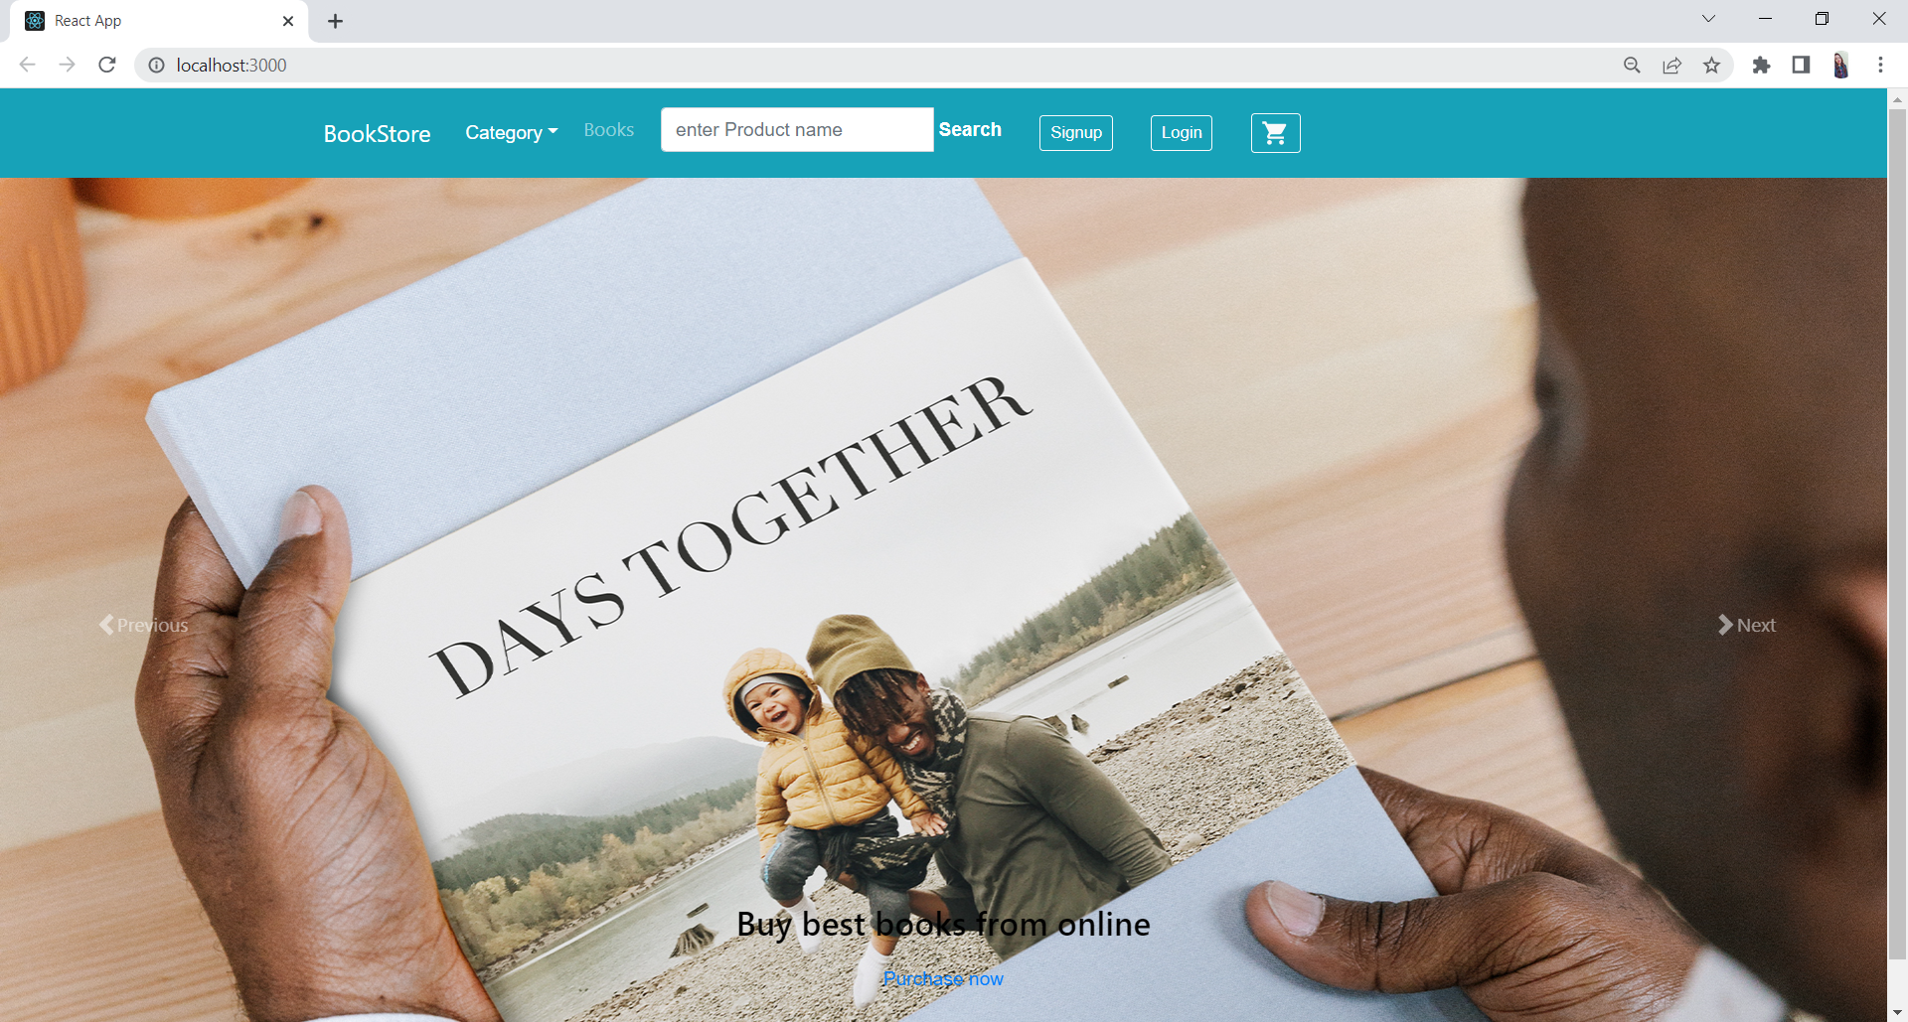

Slide 12
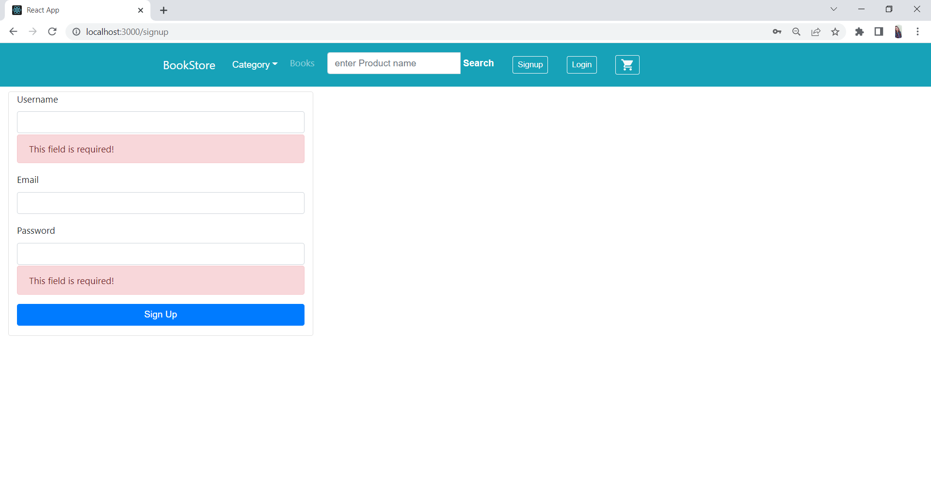
Register

Slide 13
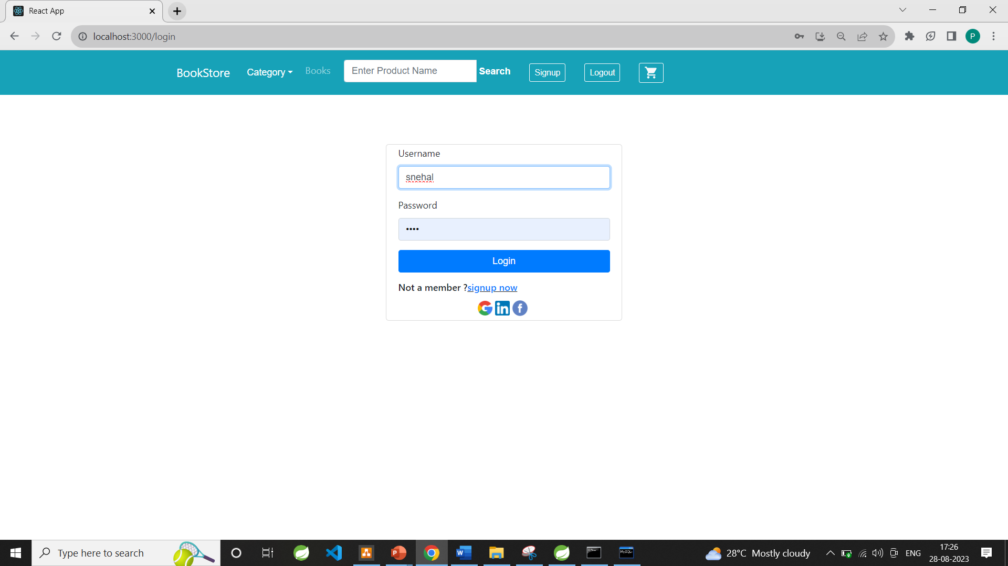
Login

Slide 14
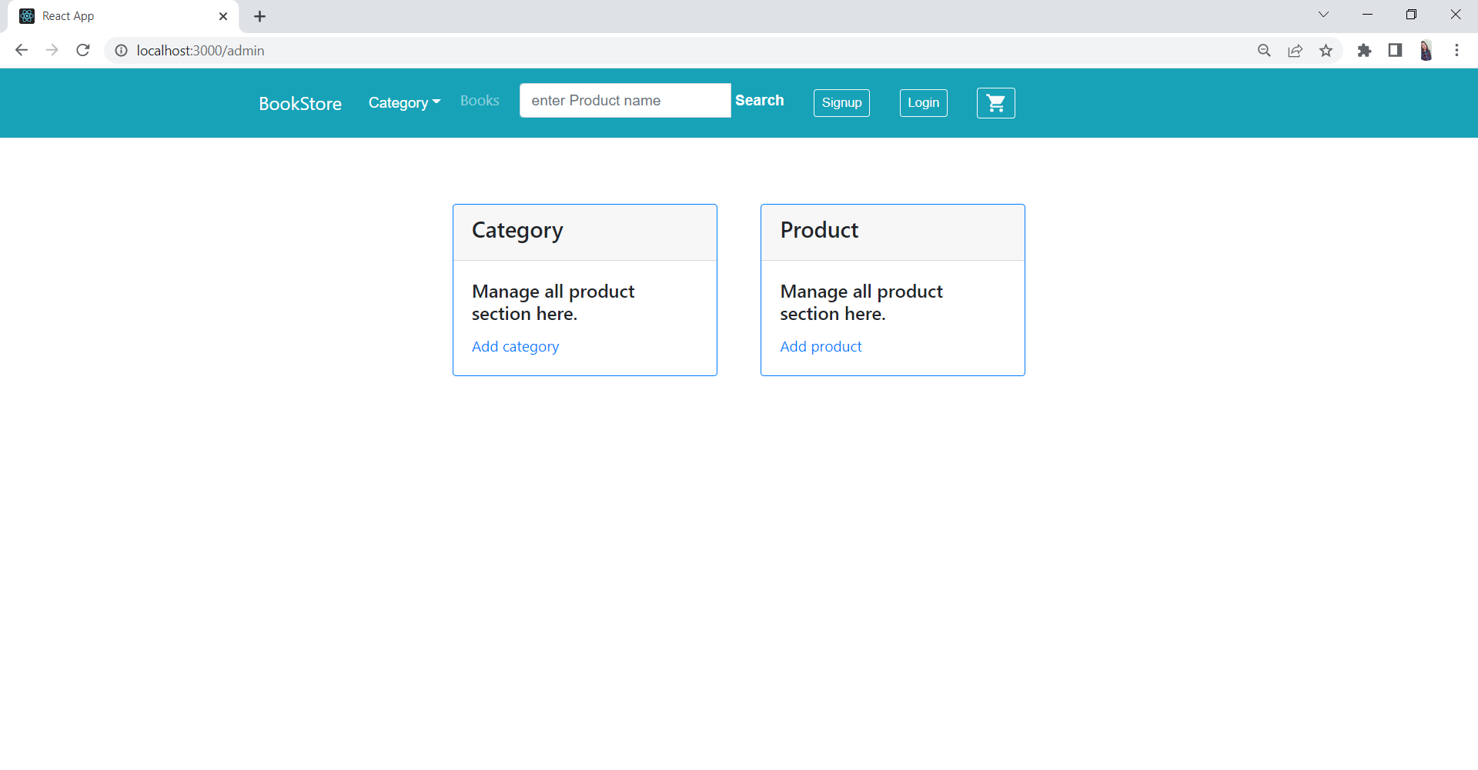
Admin

Slide 15
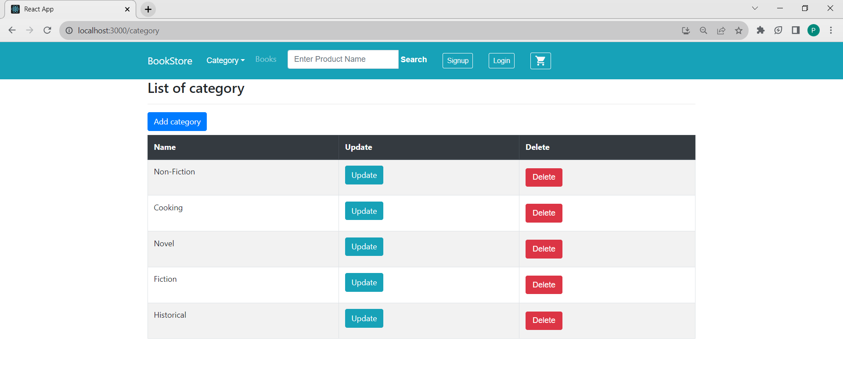
Admin - Category

Slide 16
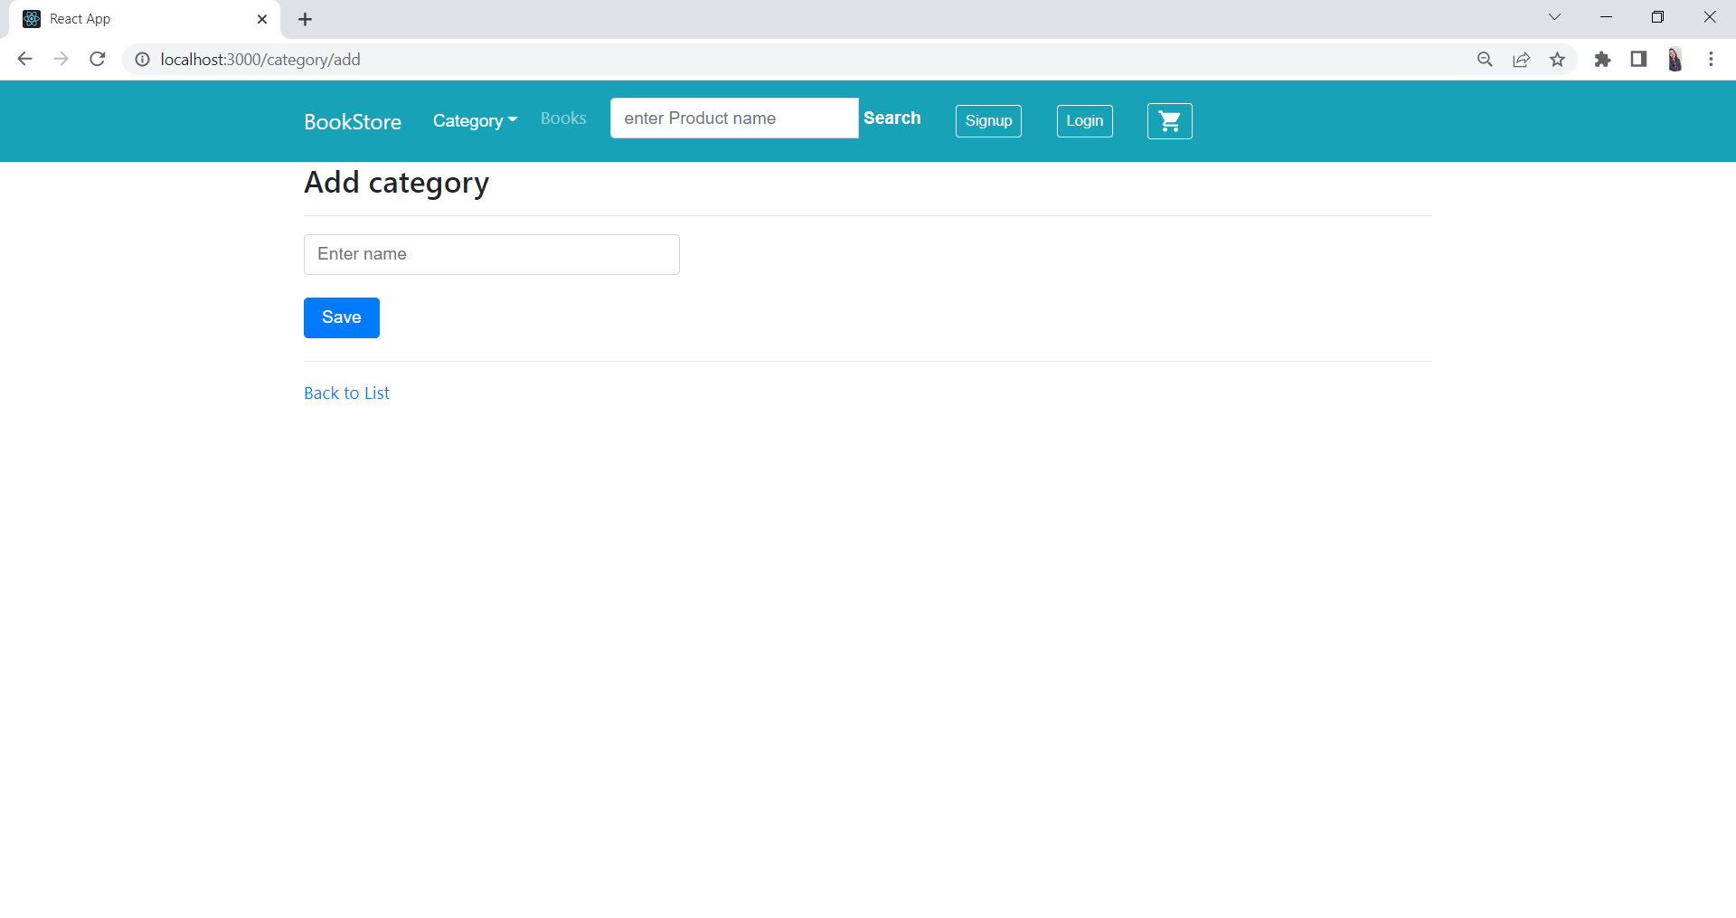
Add/Update Category

Slide 17
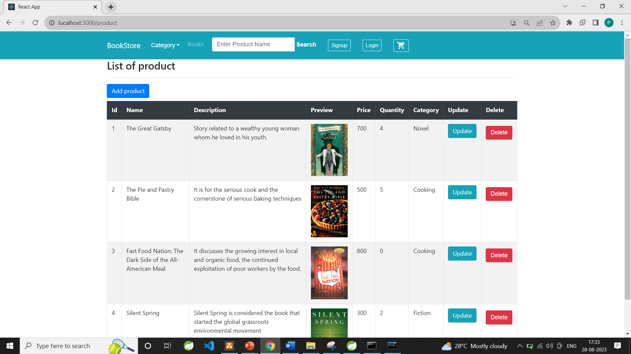
Admin-Product

Slide 18
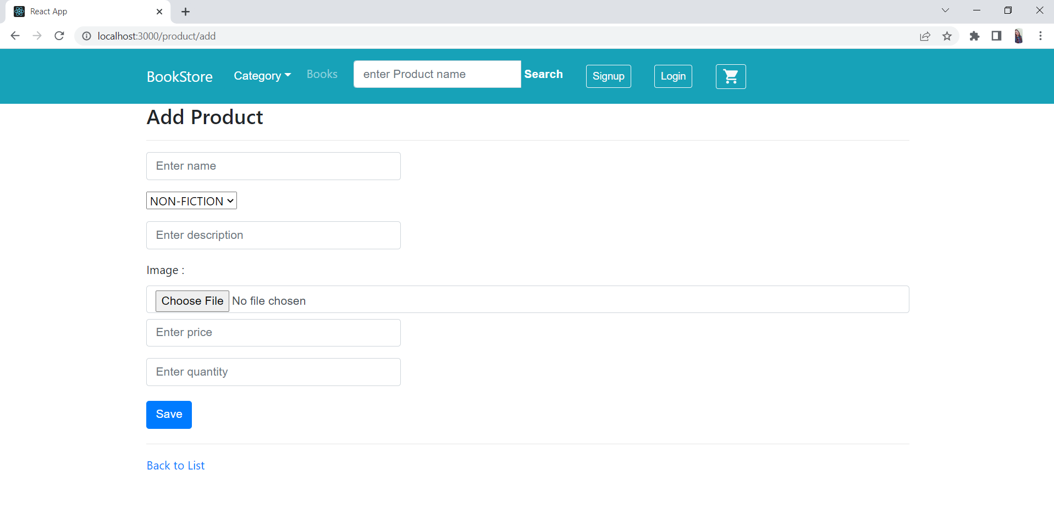
Add/Update product

Slide 19
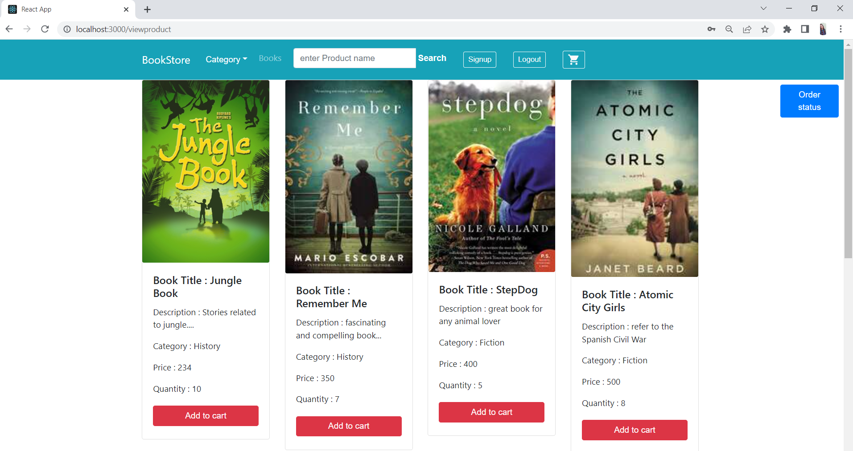
User-view product

Slide 20
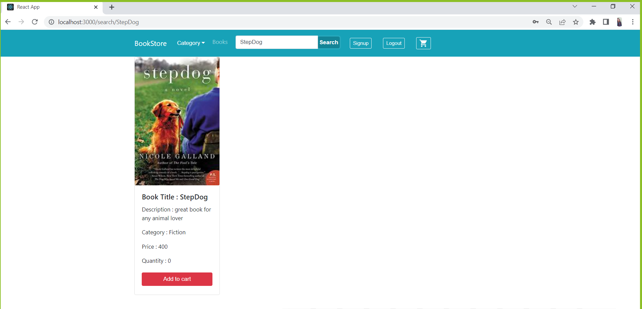
User-Search By Title

Slide 21
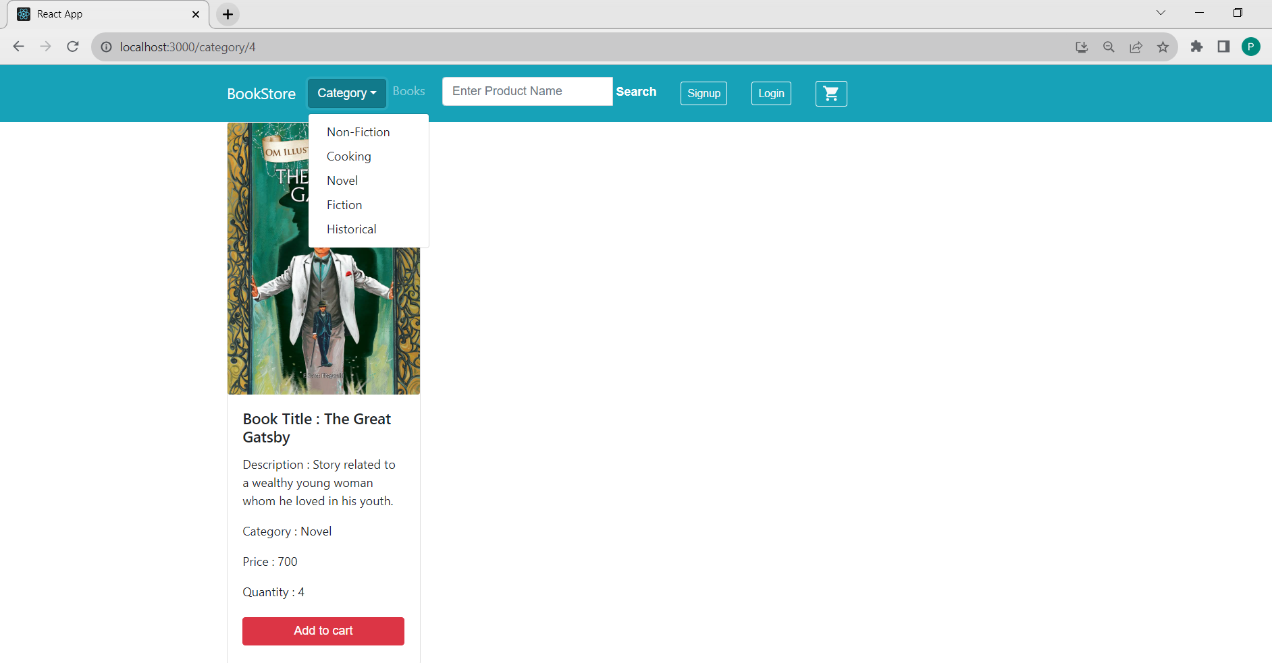
User-Search By Category

Slide 22
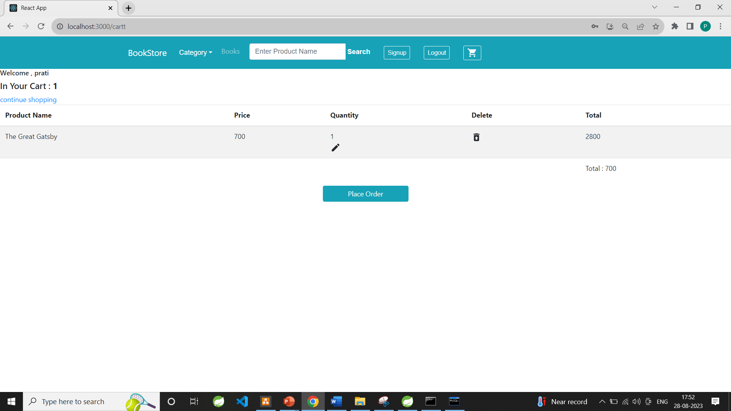
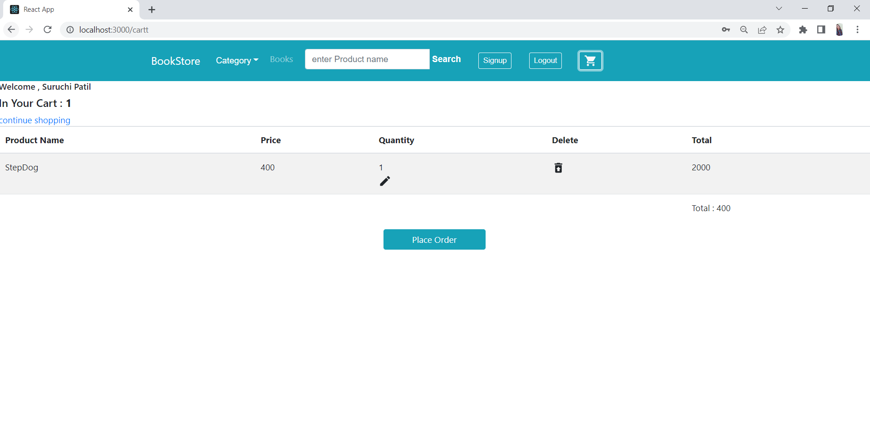
User-Cart

Slide 23
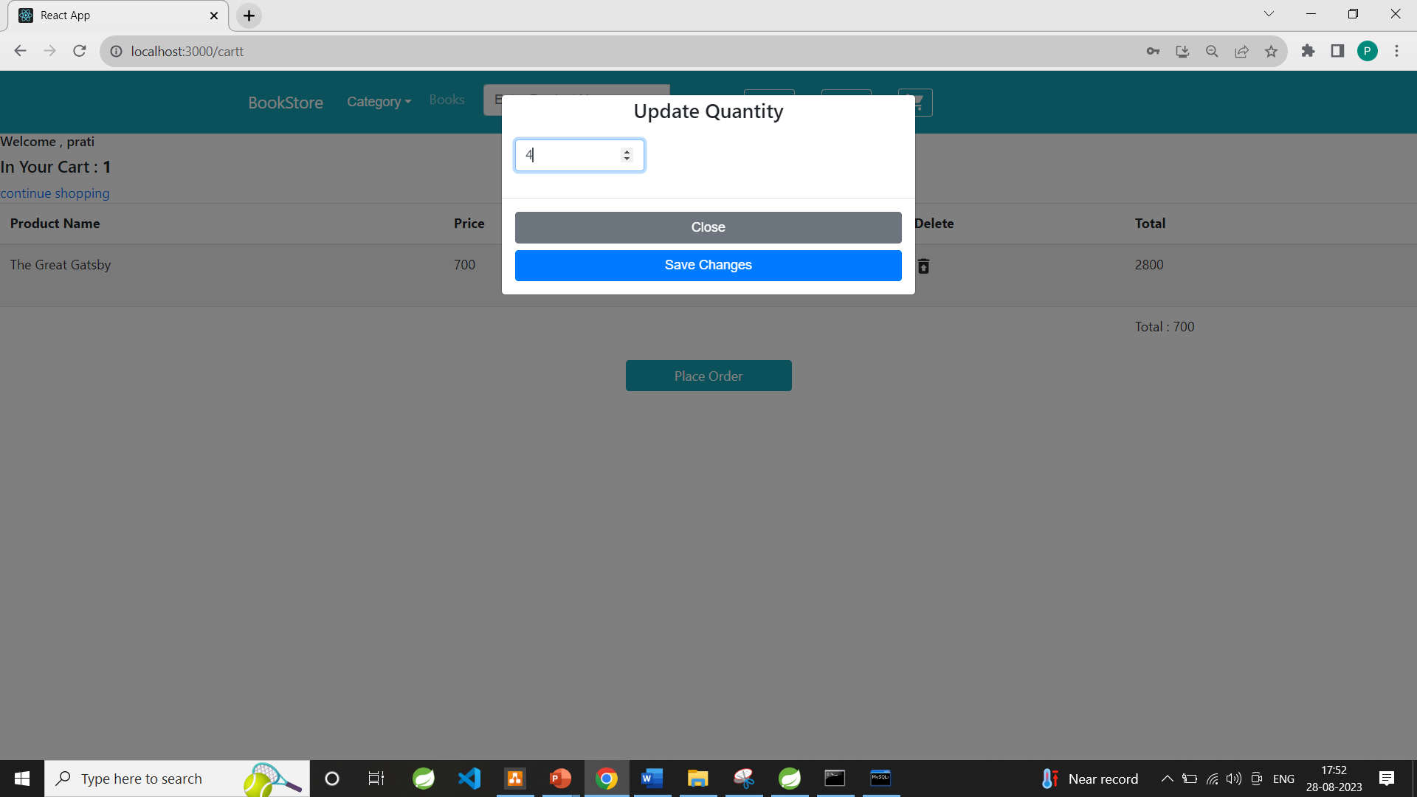
Update-Cart

Slide 24
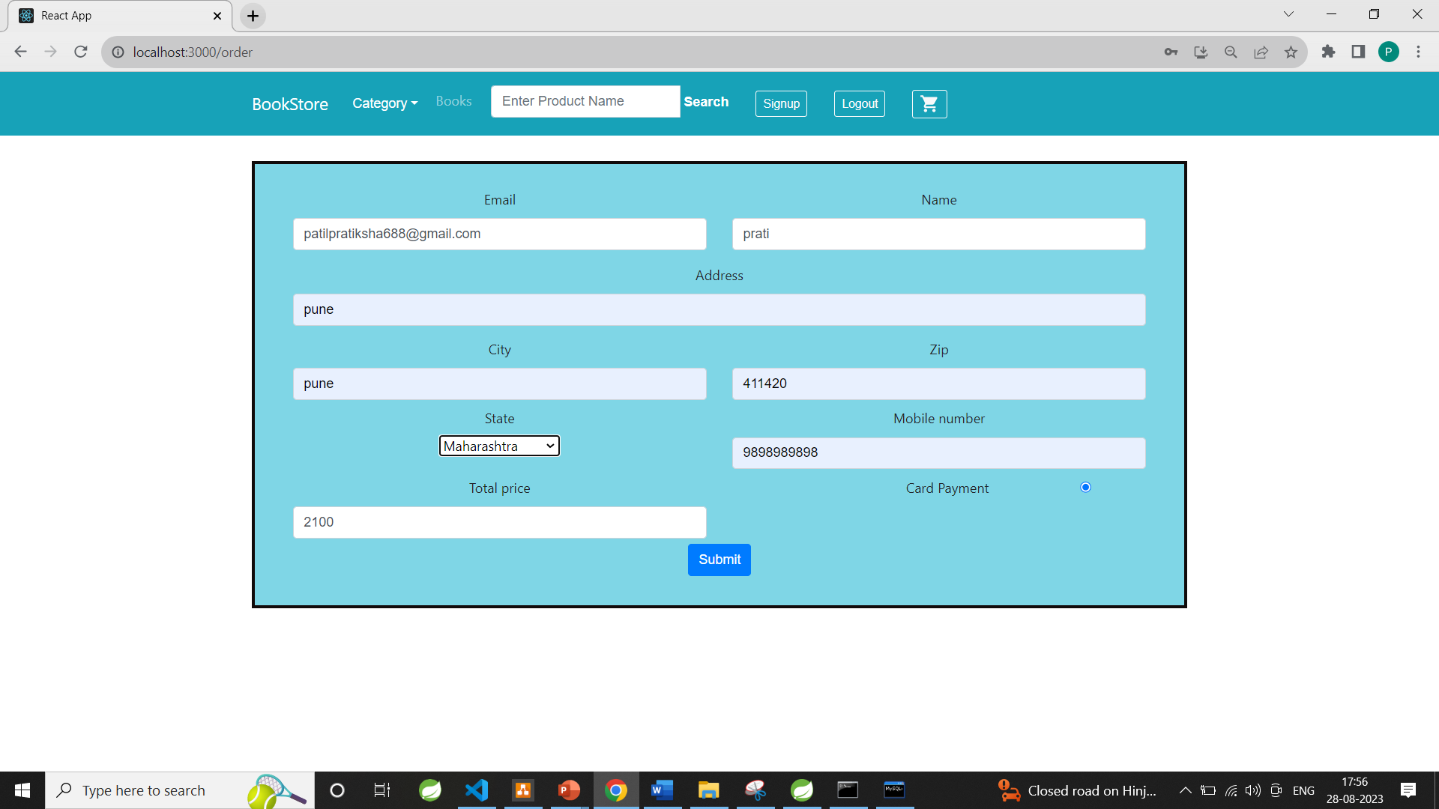
User-Order

Slide 25
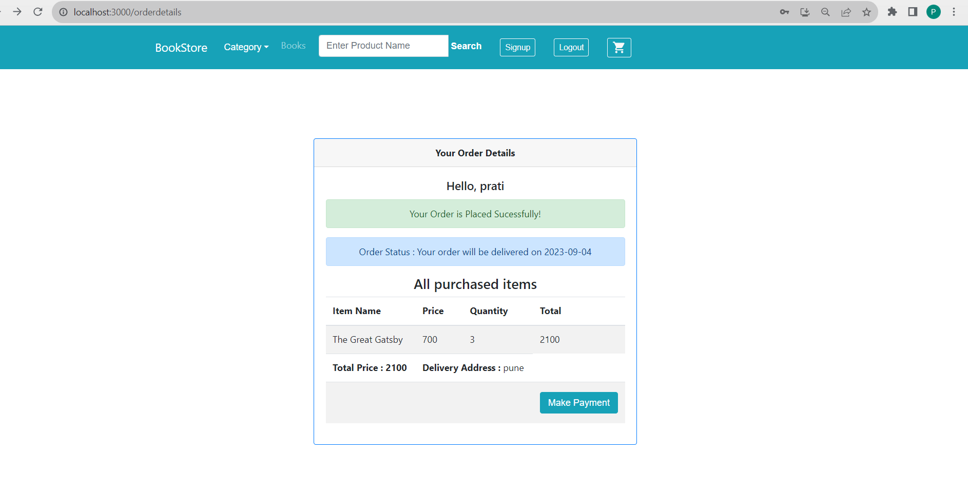
User-Order Placed

Slide 26
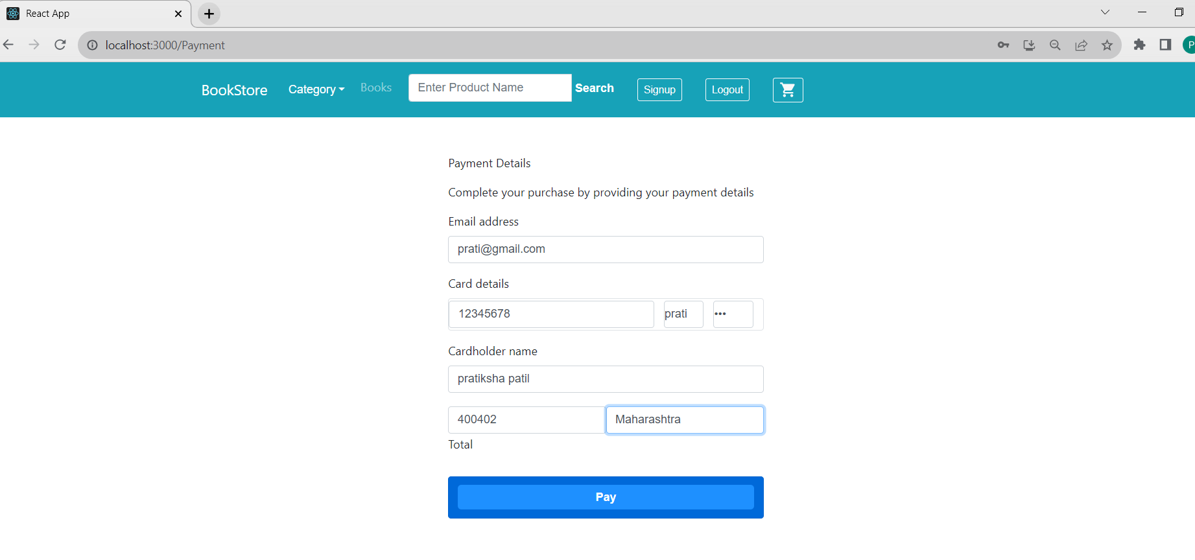
Payment-Gateway

Slide 27
Technology
Front-End-ReactJs,HTML,CSS,Bootstrap
Back-End-Spring Boot Rest Api
Database-MySql

Slide 28
Software And Hardware Requirement
Server Side:
Processor: Intel® Xeon® processor 3500 series
HDD: Minimum 500GB Disk Space
RAM: Minimum 8GB
OS: Windows 10, Linux 6
Database: MySQL
Client Side (minimum requirement):
Processor: Intel Dual Core
HDD: Minimum 80GB Disk Space
RAM: Minimum 4GB
OS: Windows 7, Linux

Slide 29
Advantages
Customer can access the website from anywhere
Adding new Product to the web-site is very easy
Get the book at your doorsteps
User Interface is user-friendly
Price of the product is justified

Slide 30
Disadvantages
Sometime the site get crash so that time no one can access that site .
Customer cannot try the product before they buy.
Sometime the in the delivery the product get damage .
E-commerce is highly compitetive.
Shipping time can be lenghty

Slide 31
Conclusion
In the competitive world if you want to grow rapidly you must use the web application to grow the business.
User-friendly interface : The web application should have an easy-to-use and intuitive interface that allows customers to quickly and easily find the books they are looking for.
Customer can order the book from any part of the country at their door steps
It is mainly different from the traditional physical bookstores, to overcome a series of physical bookstores limited

Slide 32
Future Scope
As for other future developments :-
1)User can buy some subscription plan for accessing some advanced functionality such as reading books online.
2)User need to pay some amount and then only he can enjoy 'read the book online' feature.
3)User can track the product using GPS.

Slide 33
References
https://bootstrapmade.com/mentor-free-education-bootstrap-theme/
https://www.javatpoint.com/java-mail-api-tutorial
https://www.w3schools.com/
https://reactjs.org/docs/getting-started.html
https://javaee.github.io/javaee-spec/javadocs/

Slide 34
Thank you
Any Question

